Slide 1
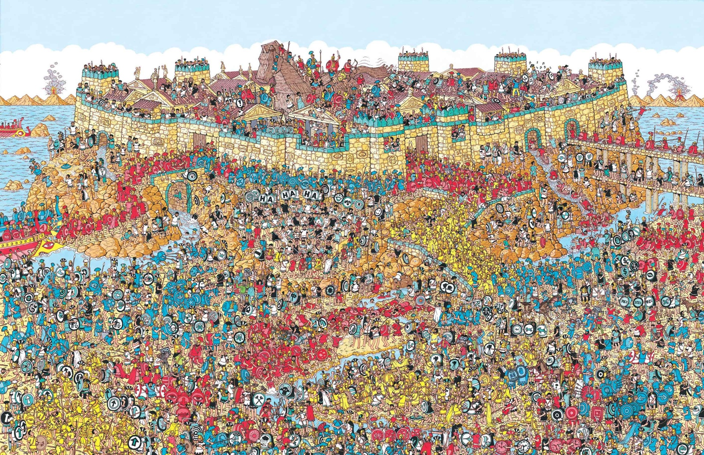
You should know the drill by now
Please Log in using your student ID
We will start at 5 past start time
Send me student ID in private chat
Apparently, Wally is hiding in this picture
!!!DO NOT SPOIL THIS FOR OTHERS!!!

Slide 2
Social interaction and comprehension
Do you want me to repeat what I just said ?
Blah Blah Blah...
Do you understand what I am saying ?
No, I was listening so repeating won’t help. I just don’t understand.
No not really

Slide 3
Social interaction and comprehension
What is it that you don’t understand.
...
He means this:
Rah Rah Rah...
I get it on a whole, it’s the detail, I don’t understand.
Oh! Yeah, I totally agree.

Slide 4
Social interaction and comprehension
I have no issue repeating myself but if you were paying attention and you still don’t understand then repeating myself will probably not help
This is not anyone’s fault, we are all different I am a post-positivist, if you know what that means :D
Alternate knowledge sources can provide different perspective such as other people like other tutors, students...
Help each other out This is part of what is referred to as “Team Spirit” this is why I keep pushing for being social

Slide 5
Think about who you can talk to if something I say doesn’t make sense to you
What is it that doesn’t make sense ?
Why doesn’t it make sense ?
Who can help you ?

Slide 6
Assignment 1
Was released on Monday
Who has read it ?
Let’s go through it together

Slide 7
Week 7
Revisions
Assignment 1
Trees
Heap Insert
Heaps
Heap Delete

